Slide 1
POLLING SYSTEM
BY
Simon Leonard D (1831051)
Vignesh Ganesan (1831056)

Slide 2
Aim
To create polling system using assembly language
To prevent false voting and duplicate voters

Slide 3
Modules
There are 2 modules
Election Commissioner
Voters
Election Commissioner
Election Commissioner has the power to check the final result of election with the administrator password.
Voters
Each Voter has a unique Id for voting. Once the id is used once it cannot be reused by same or different voter for voting of same or different candidate.

Slide 4
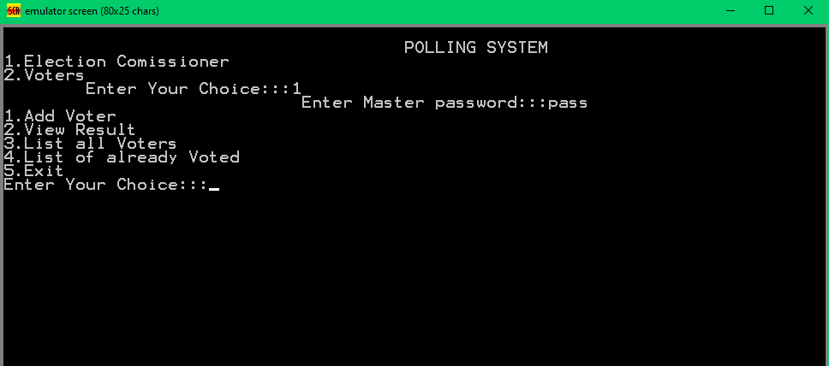
Functionalities
Election Commissioner has 5 Functionalities

Slide 5
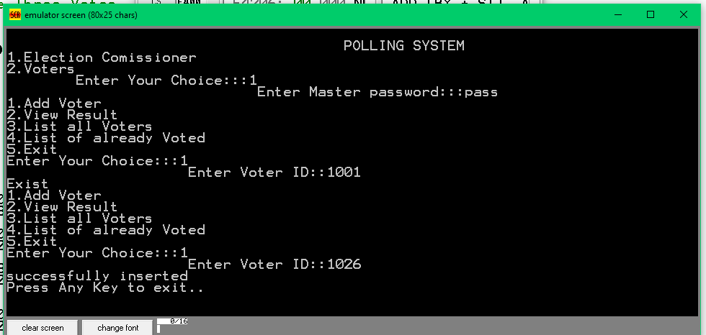
Adding Voter
It is the first functionality of election commissioner

Slide 6
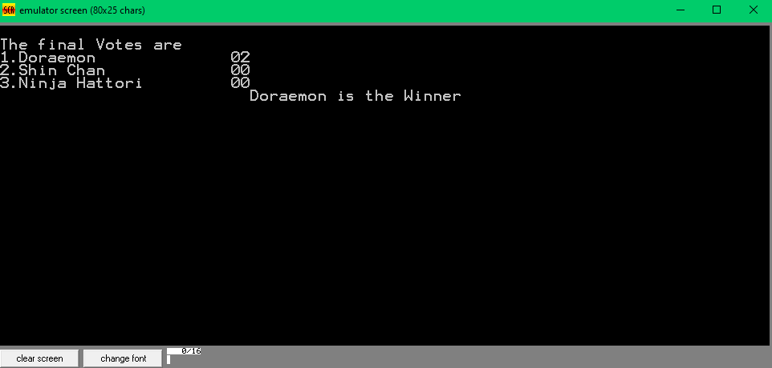
View Result
It is the major functionality of election commissioner

Slide 7
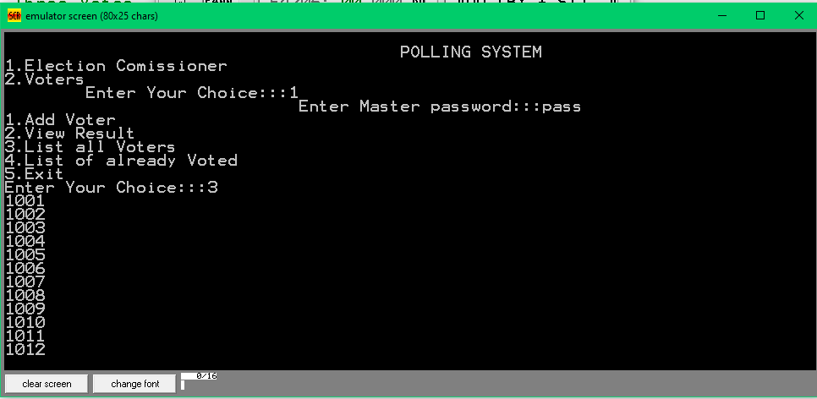
Listing All Voters
Check No. of Voters in the election

Slide 8
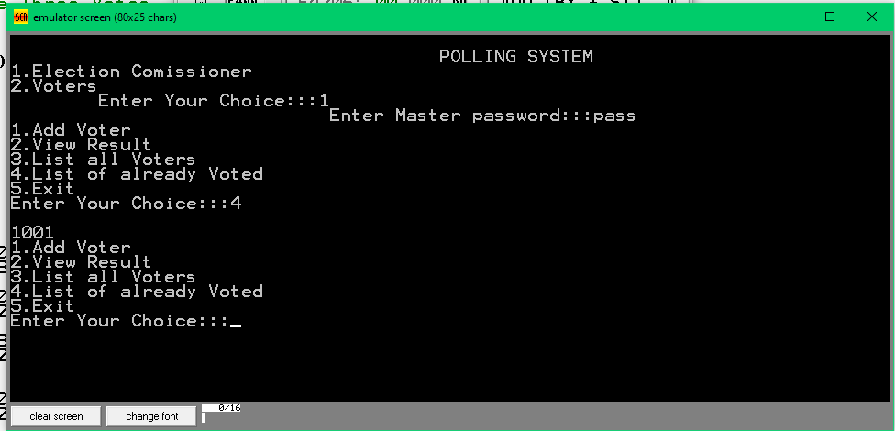
Already Voted List
To check the no.of.voters voted once the election is completed.

Slide 9
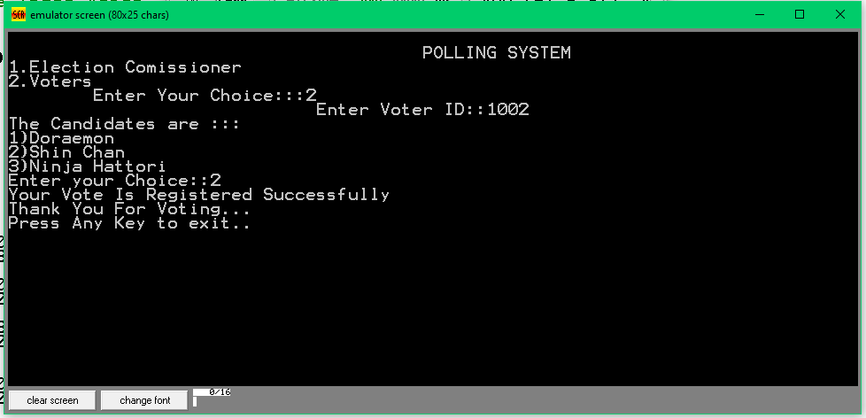
Voters-Voting
Voters provide their voting id and provide their voting.

Slide 10
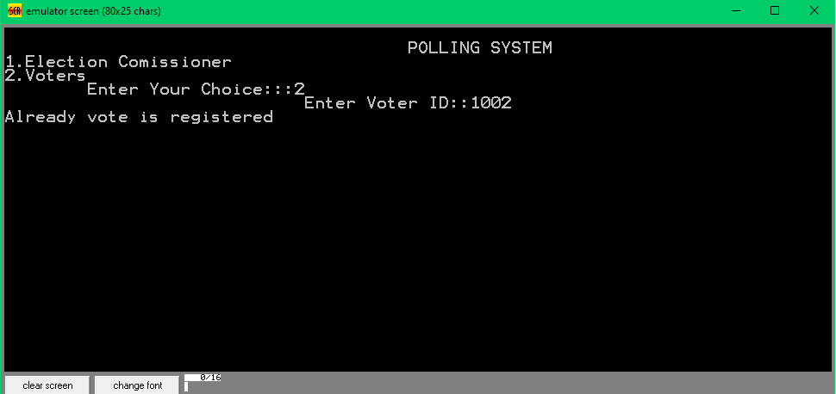
Checking voter ID’s already Exist

Slide 11
THANK YOU

